Slide 1
DevSecOps: Secure Cloud Enclaves
Sprint Review
Sprint 1: Feb 01 - Feb 21
Ethan McIlhenny, Avantika Dasgupta, Josh Manning, Dharmit Dalvi

Slide 2
Client Overview

Slide 3

About Jackpine Technologies Corporation
Products:
CONS3RT
HMC (government agencies)
Clients:
Department of Defense
US Government
Focus:
Security Solutions
User self service
Mentors:
Peter Walsh
Joe Yennaco
Mike Loebl

Slide 4
Vision and Goals

Slide 5
Vision: Firewalls Just Don’t Cut It
Everything is connected to the Internet
Entirely firewalled systems are rare nowadays (even on-prem)
Can’t simply whitelist, everything is dynamic
Non-static IPs, various endpoint devices, etc.
New methods must be implemented...

Slide 6
What to Do?
Log everything in the system… Well, not quite
Critical events: log ins/outs, starting a system/service, changing settings, etc.
Timestamp, user, system, device
Now attacker actions are logged
But now attackers have a target!
Audit logs are kept under strong access control
But all this is labor intensive… Let’s automate
CONS3RT: cloud & security orchestration service

Slide 7
Project Description

Slide 8
Scope
Storage
Logging
Accounts & Credentials
Keys & Encryption
Java Workflow
Minimum Viable Product
Stretch Goals

Slide 9
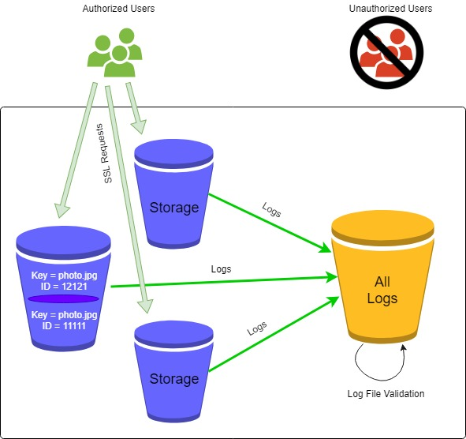
Storage & Logging
Automating the following:
Creating object storage buckets
Creating a bucket to store logs
Disabling public read/write
Enabling object versioning
Allowing only SSL requests
Enabling log file validation

Slide 10
Accounts & Credentials
A 60-day maximum password lifetime will be imposed on:
User credentials
Application credentials
Passwords will adhere to a specification of a case sensitive 8-character mix of at least one of each of:
Upper case letters
Lower case letters
Numbers
Special characters

Slide 11
Stretch Goals
Keys & Encryption
Enabling encryption on storage buckets
All objects will be encrypted when they are stored
Encrypting volumes
Java Workflow
Combining automation scripts into a consolidated Java workflow
Envisioned to be released as a part of CONS3RT
Feature similar to an existing one for AWS - one click security installation

Slide 12
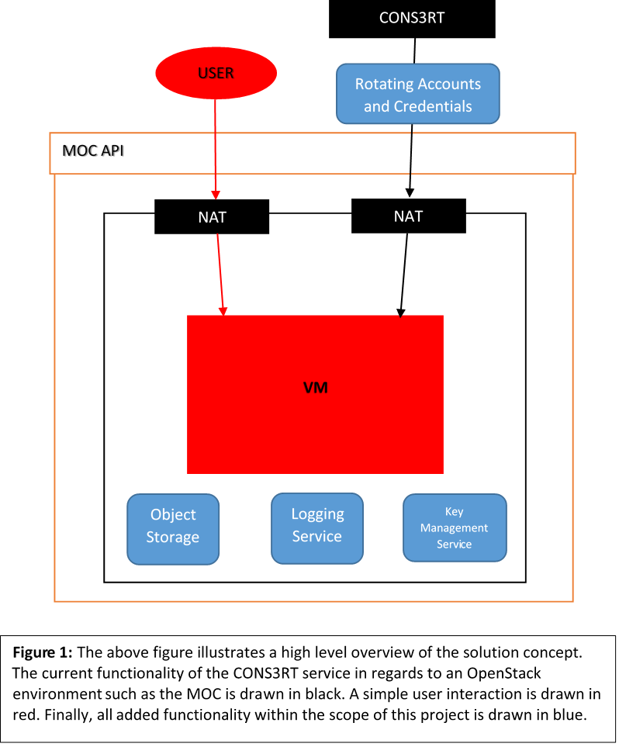
Solution Concept
Storage
Underlying CEPH storage
Swift for Object Storage
S3 Interfacing for creation of buckets
Logging
FluentD
KMS
Barbican
PyKMIP

Slide 13
Effort Estimation

Slide 14
User Stories
Taiga Sprint 1 Taskboard

Slide 15
Progress

Slide 16
Burndown Chart
Burndown Chart

Slide 17
Research and Questions

Slide 18
Initial Tenable.io Test
Tenable.io is a vulnerability management tool
A VM was created in MOC as with the instructions set forth on the “How Tos”
A simple Network Security Scan was successfully run on the VM
Further customization of the scans will be done in the future to exploit the security risks that we are trying to fix
CONS3RT has a built in Nessus Agent that gives a PDF report of the system vulnerabilities

Slide 19
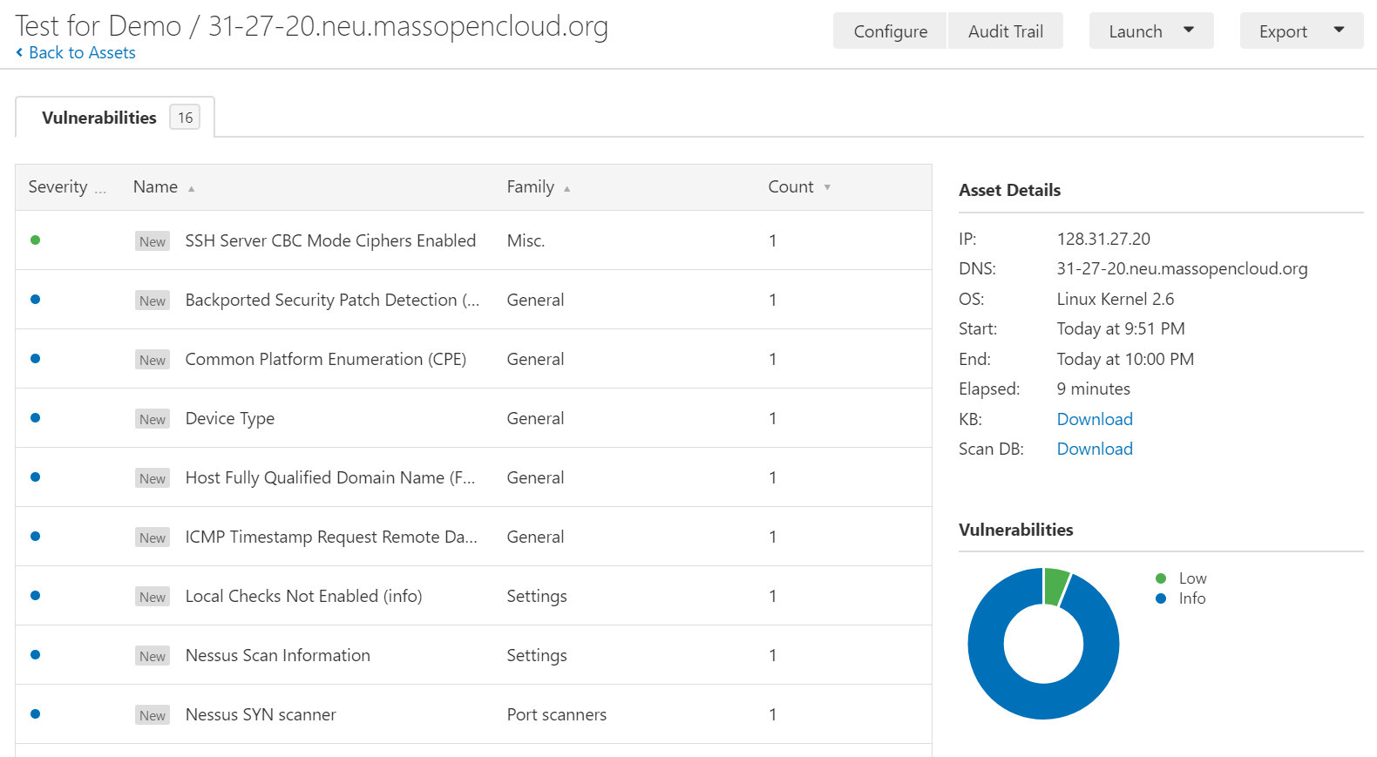

Slide 20
Questions Yet to be Answered
Is the MOC FluentD compatible? Or will we have to revert back to using ELK Logstash?
What does the “Forbidden” error mean from our script? Is all API access to the MOC down?
Does OpenStack have an analogous entity to regions in AWS? How do we fold this into S3 interfacing with Swift?
How can Tenable.io be customized to best evaluate the security of our VMs?

Slide 21
Demo

Slide 22
CONS3RT DEMO
Steps involved in setting up a virtual system:
Basic info:
System type
System name
Description (Optional)
Operating System
Configuration
CPU count
Memory
Boot disk
Install software
Review
Launch System
CONS3RT

